Slide 1
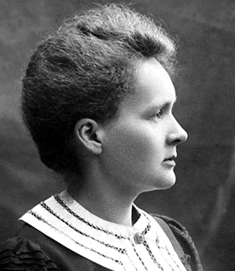
Marie Curie

Slide 2
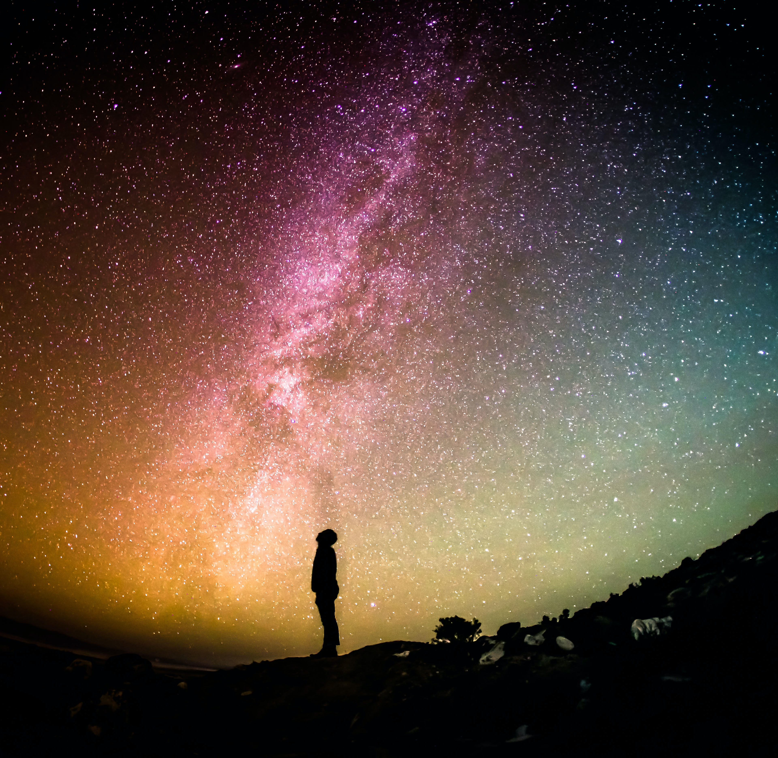
Think of some things which glow.
Slide 1

Slide 3
What about this?
Slide 2

Slide 4
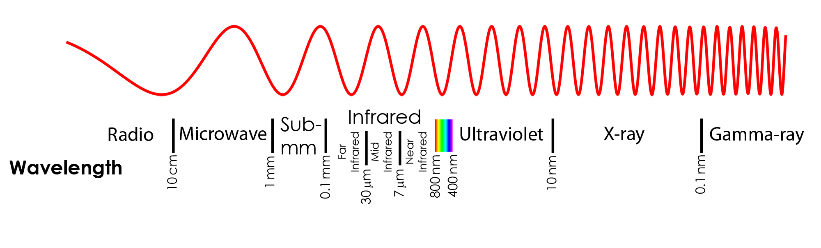
A type of energy, called electromagnetic radiation, travels in packets in a wave like motion.
Our eyes can detect some electromagnetic waves – we call this visible light.
X-rays and Gamma-rays are high frequency. Our eyes cannot detect these.
Slide 3

Slide 5
Cherenkov radiation in the Reed Research Reactor
Slide 4

Slide 6
Uranium
Slide 5

Slide 7
Photo credits: Stars – Unsplash Other images – Wikipedia public domain
© HMDT Music 2020

